Slide 1
Inventory Management System Juamal Blackman

Slide 2
About me

Slide 3
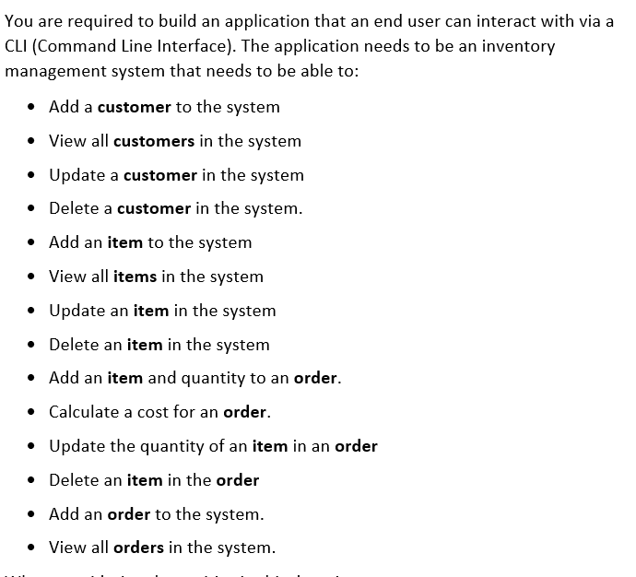
Project Specification

Slide 4
Analysis and design

Slide 5
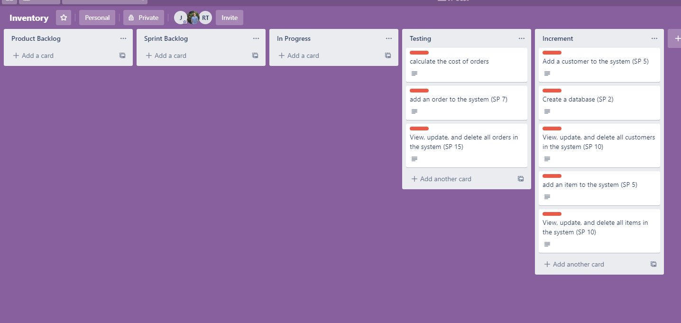
Trello Board

Slide 6
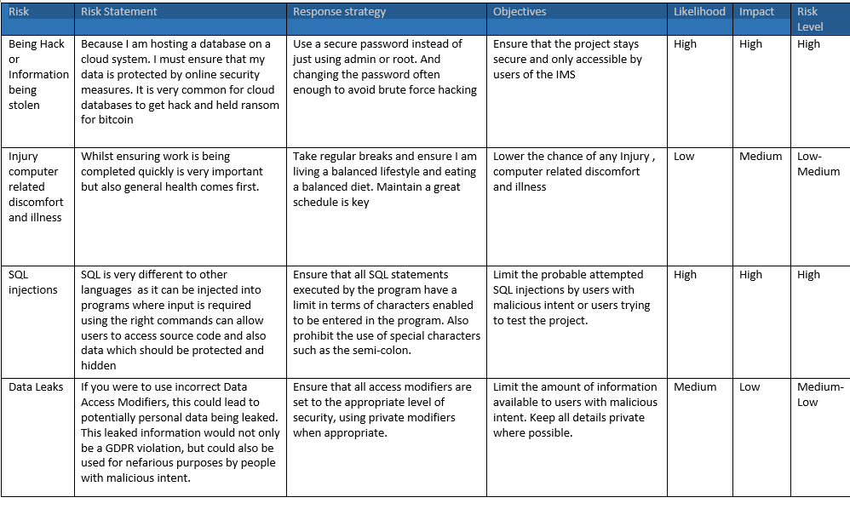
Risk Assessment

Slide 7
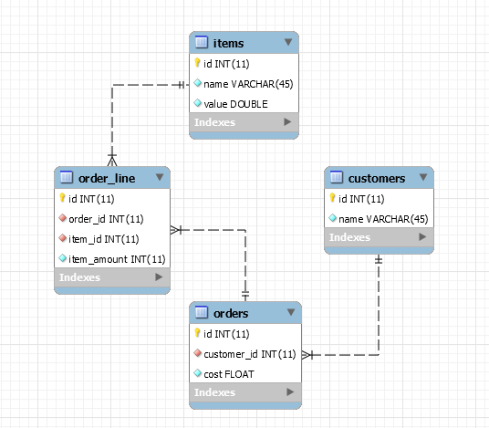
Entity Relationship Diagram

Slide 8
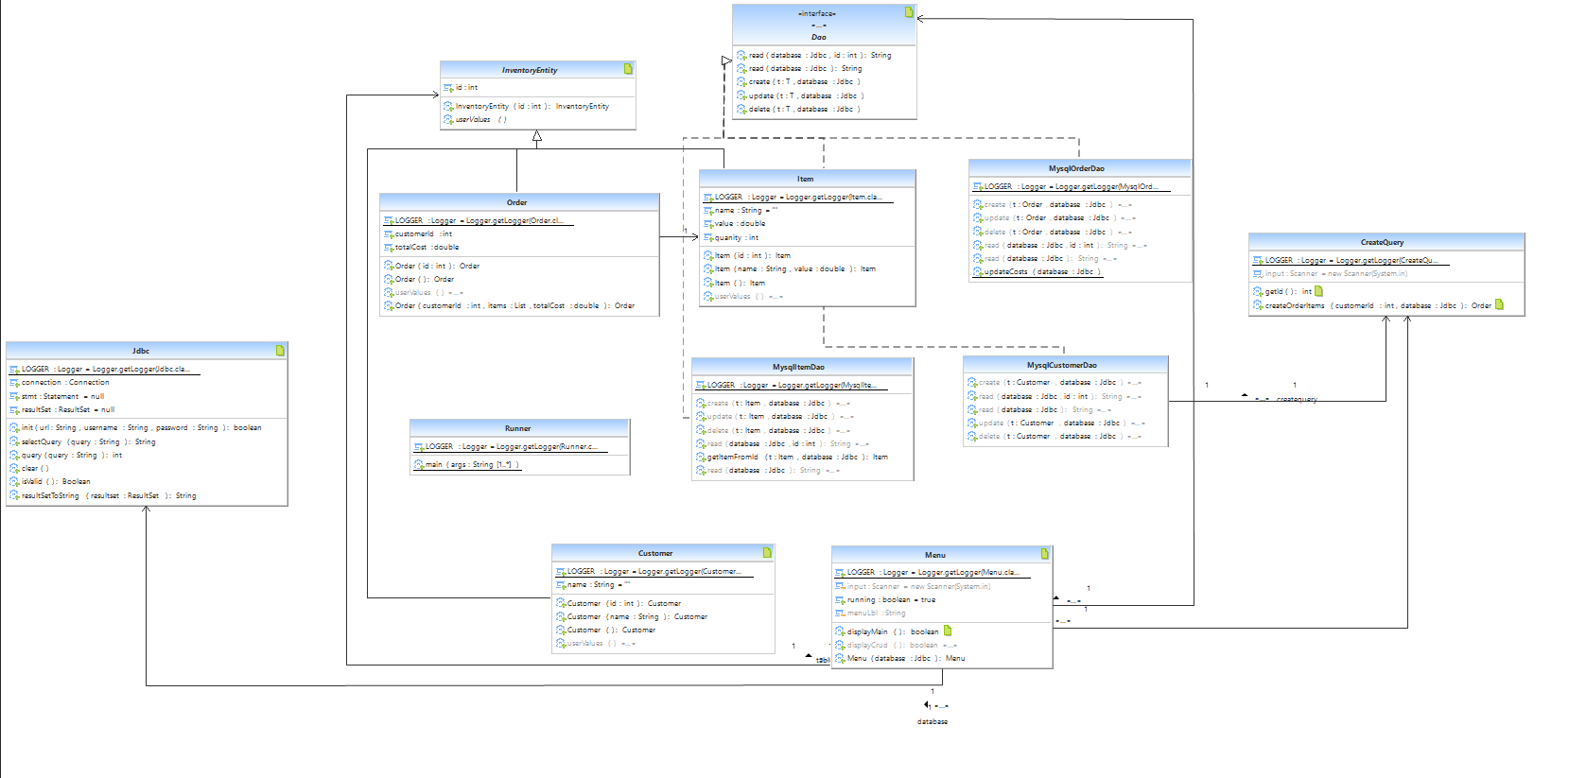
UML Diagram

Slide 9


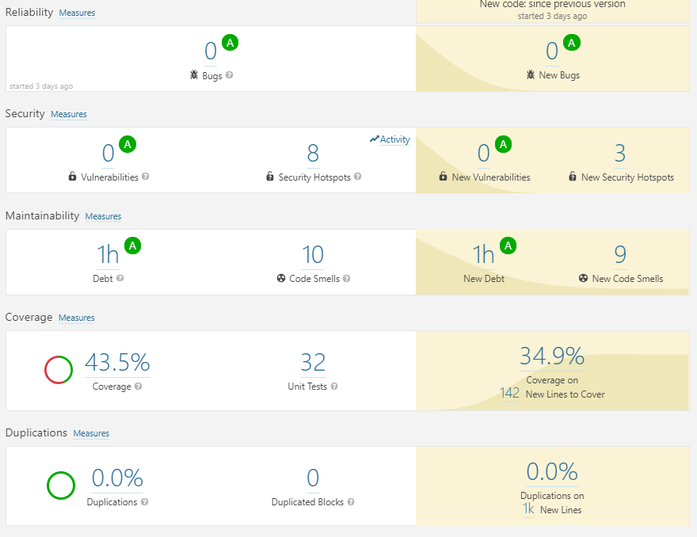

Testing

Slide 10





Continuous Integration

Slide 11
What I learned

